Slide 1

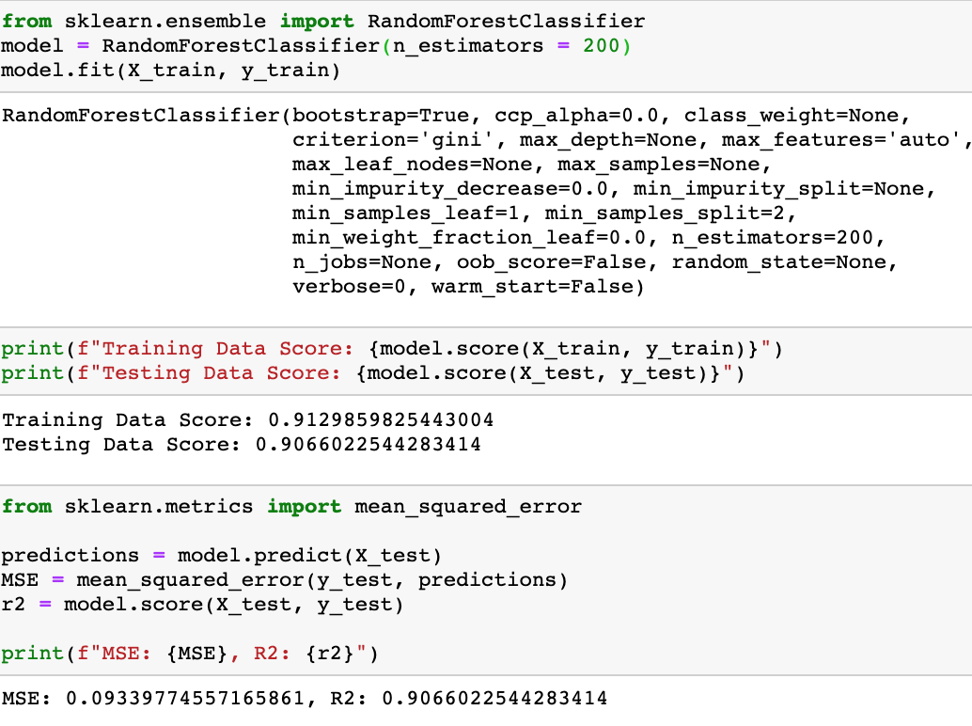
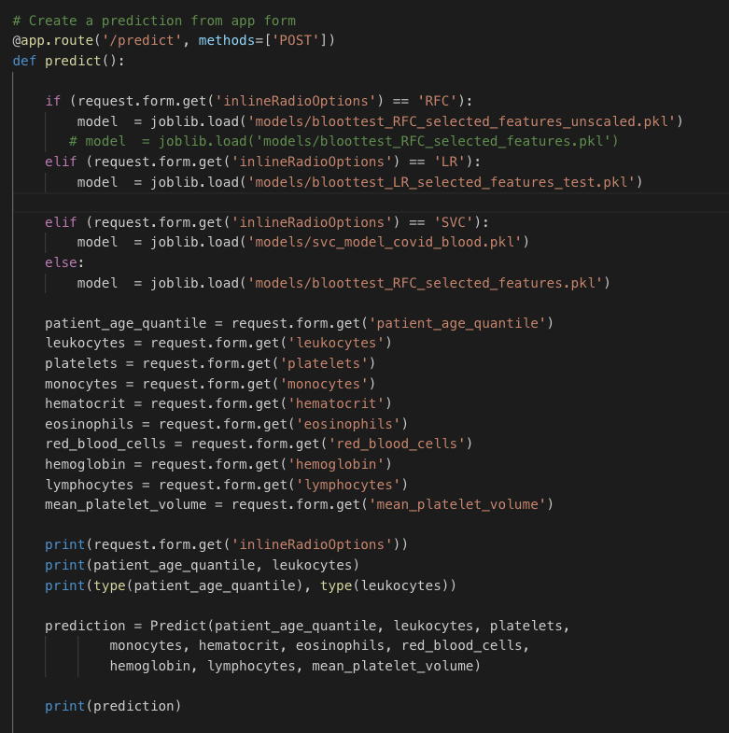
COVID-19 Prediction Models Based ON Non-COVID Lab Tests
The COVID Story
Data, Preprocessing, Modeling
Full Stack Deployment
Arundhati Chakraborty • David Jaimes • Grant Thompson • Alexis Perumal
UCSD Data Science and Visualization Boot Camp
May 13, 2020

Slide 2
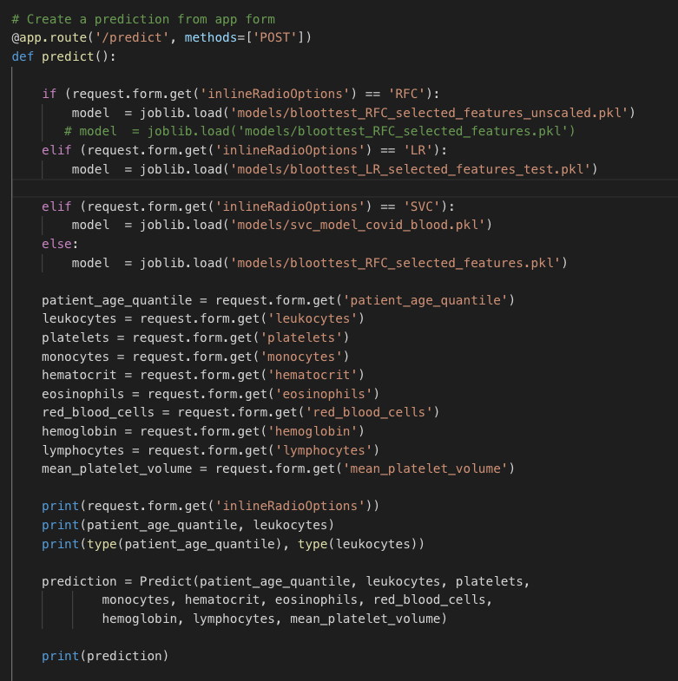
COVID-19 Prediction Models Based ON Non-COVID Lab Tests
The COVID Story
Data, Preprocessing, Modeling
Full Stack Deployment
Arundhati Chakraborty • David Jaimes • Grant Thompson • Alexis Perumal
UCSD Data Science and Visualization Boot Camp
May 13, 2020

Slide 3
Story:
Alexis – add more story
We set out to determine if we can reasonably predict COVID-19 test results based on standard laboratory tests (blood, urine, etc) since these tests a more accessible.
We took the data from the Kaggle https://www.kaggle.com/einsteindata4u/covid19, created by the Hospital Israelita Albert Einstein in São Paulo, Brazil.
Total data of 5,644 patients were taken consisting of over 100 columns of patients Laboratory test results, out of which top 10 columns were selected based on the model scores. In this project we have used several models( Logistic Regression, Random Forest Classifier, SVC etc ) for possible prediction of the test result for COVID-19 (positive/negative) based on the below listed column features:
- patient_age_quantile
- leukocytes
- platelets
- monocytes
- hematocrit
- eosinophils
- red_blood_cells
- lymphocytes
- hemoglobin
- mean_platelet_volume

Slide 4
Project Steps
Data Exploration
Model Building of several models with evaluation
Website development including input form
Findings and Conclusions

Slide 5
Libraries, Packages and Platforms
ML Analysis: SciKit-Learn (Classifiers and Regressors), Pandas, SimpleImputer, TensorFlow (neural networks), Jupyter Notebooks, Python
Server: flask, flask-sqlalchemy, flask-marshmallow, marshmallow-sqlalchemy
Visualization: html, bootstrap, css
Database: SQLite
Postman (collaboration platform for API development.)

Slide 6
Project Structure

Slide 7
COVID-19 Prediction Models Based ON Non-COVID Lab Tests
The COVID Story
Data, Preprocessing, Modeling
Full Stack Deployment
Arundhati Chakraborty • David Jaimes • Grant Thompson • Alexis Perumal
UCSD Data Science and Visualization Boot Camp
May 13, 2020

Slide 8
Model Building: Pre-processing the data
After downloading the csv files from :
https://www.kaggle.com/einsteindata4u/covid19
- The Initial columns used : ["patient_id","patient_age_quantile","sars_cov_2_exam_result","hematocrit","hemoglobin","platelets","mean_platelet_volume","red_blood_cells","lymphocytes","mean_corpuscular_hemoglobin_concentration_mchc","leukocytes","basophils","mean_corpuscular_hemoglobin_mch","eosinophils","mean_corpuscular_volume_mcv","monocytes","red_blood_cell_distribution_width_rdw","serum_glucose"]
-There were many rows of missing data, we implemented models using both dropping the NaNs and by filling up the missing data using Imputer library by ‘mean’
Based on the model score for each column we selected top 10 features/Tests to save our final models :
['patient_age_quantile', 'leukocytes', 'platelets', 'monocytes', 'hematocrit', 'eosinophils', 'red_blood_cells', 'lymphocytes', 'hemoglobin', 'mean_platelet_volume’]
- We didn’t use standardization/Normalization and fitting for any of our models since the above feature data was within the same range

Slide 9
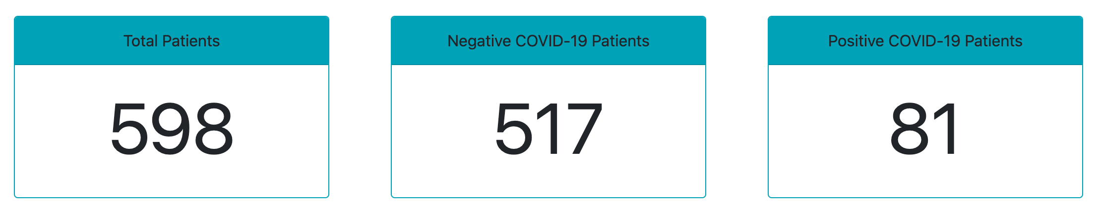
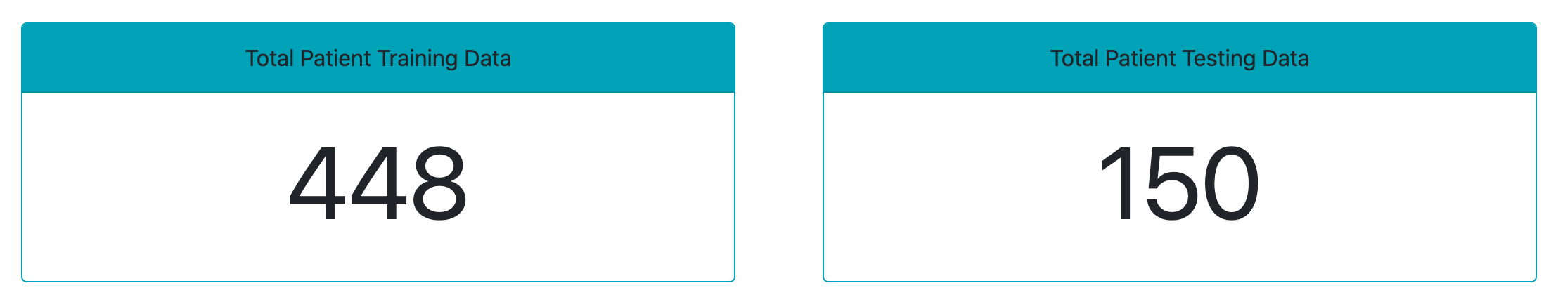
Logistic Regression Model
PROS
Most popular, simple, and efficient.
Binary classification and discrete outcome.
No scaling required for x inputs.
CONS
Can’t solve non-linear problems.
Outperformed by other complex algorithms.
Vulnerable to overfitting.

Slide 10
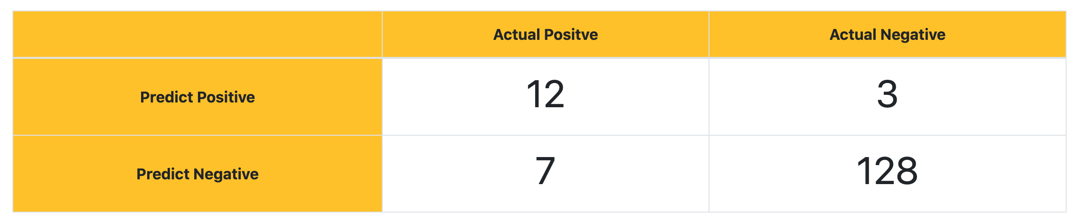
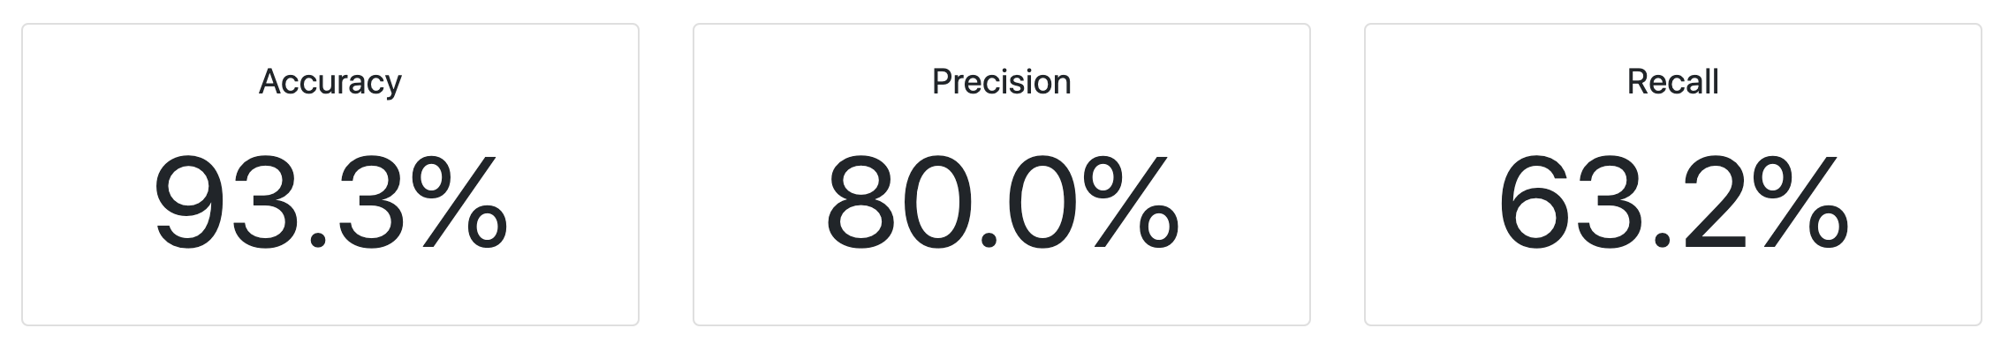
Logistic Regression Model

Slide 11

Random Forest Classifier Model
It is an ensemble tree-based learning algorithm. The Random Forest Classifier is a set of decision trees from randomly selected subset of training set. It aggregates the votes from different decision trees to decide the final class of the test object.

Slide 12
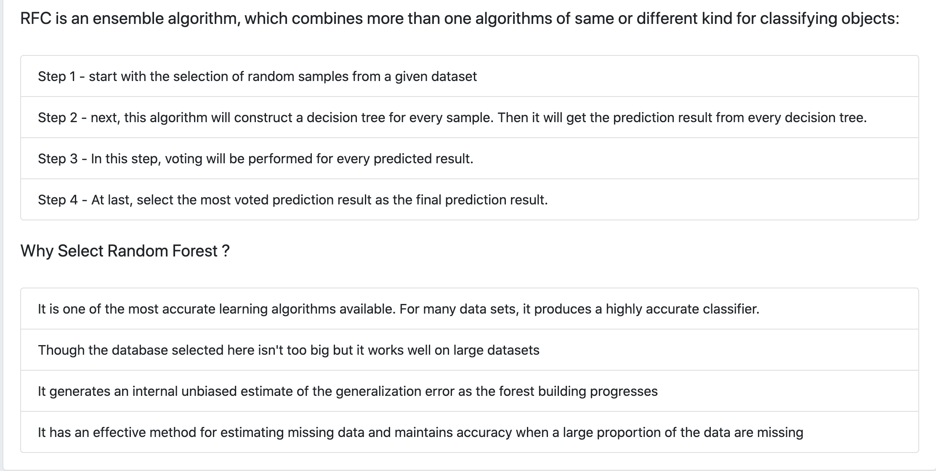
Random Forest Classifier Model Continued

Slide 13
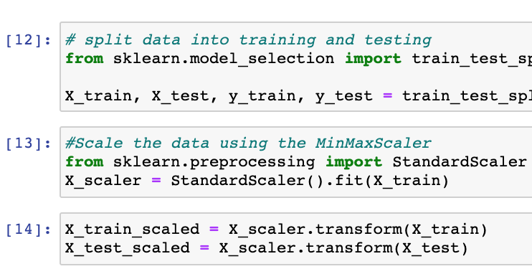
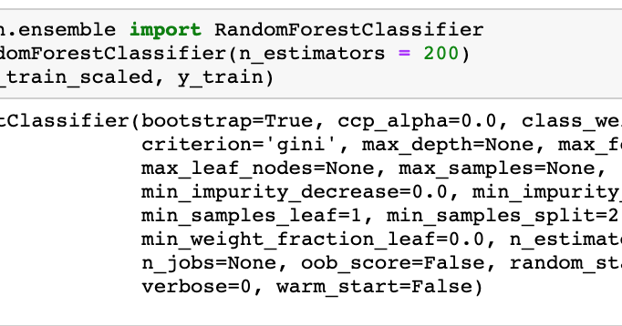
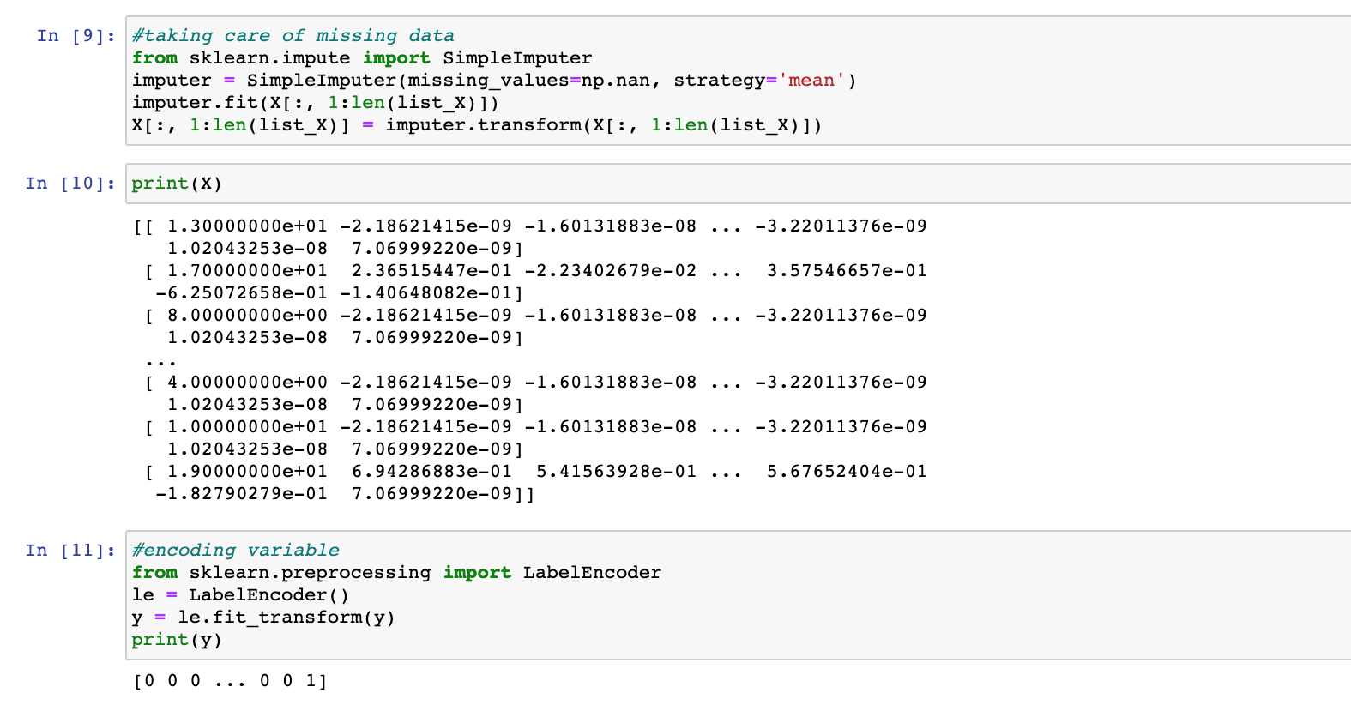
Random Forest Classifier Model Continued, Steps :
1.Importing Python libraries and Loading our dataset, preprocessing
2. Splitting our dataset into training set and test set
3. Creating a Random Forest Regression model and fitting it to the training data
4. Predicting the test set results and making the Confusion matrix
5. Further tuning of the model based on top 10 scoring features that contributes to the prediction :
param_grid = {
'n_estimators': [200, 600, 1200, 1400],
'max_features': ['auto', 'sqrt', 'log2'],
'max_depth': [14, 15, 16, 17, 18, None]
}

Slide 14
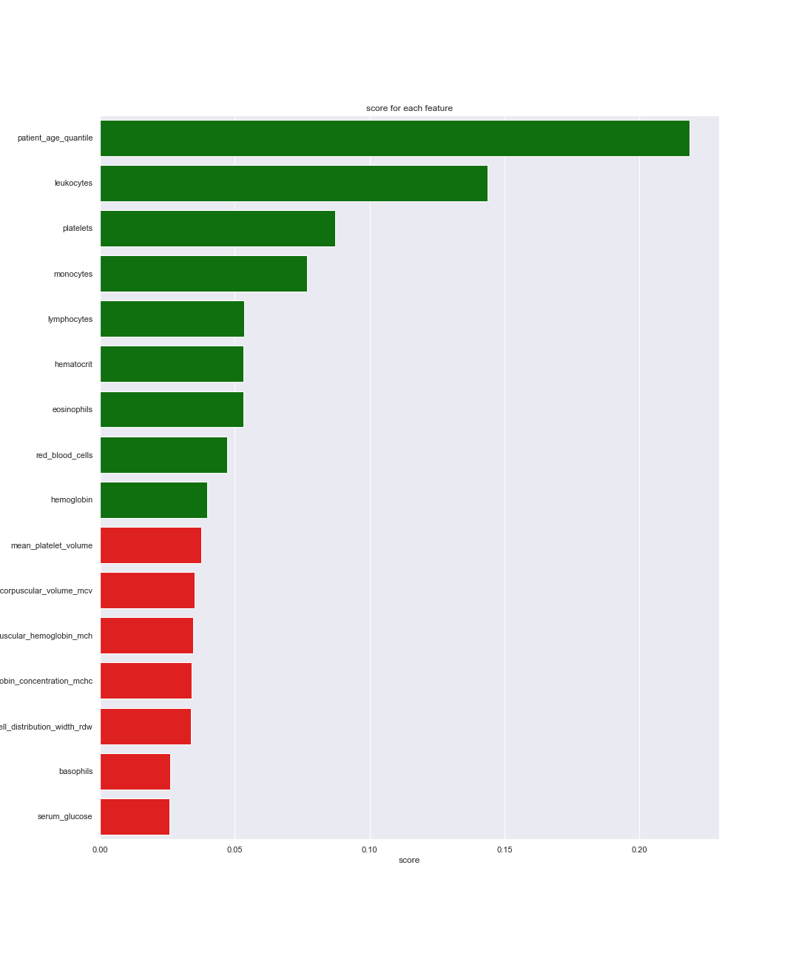
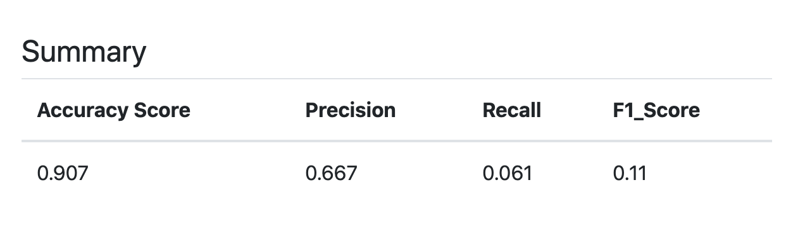
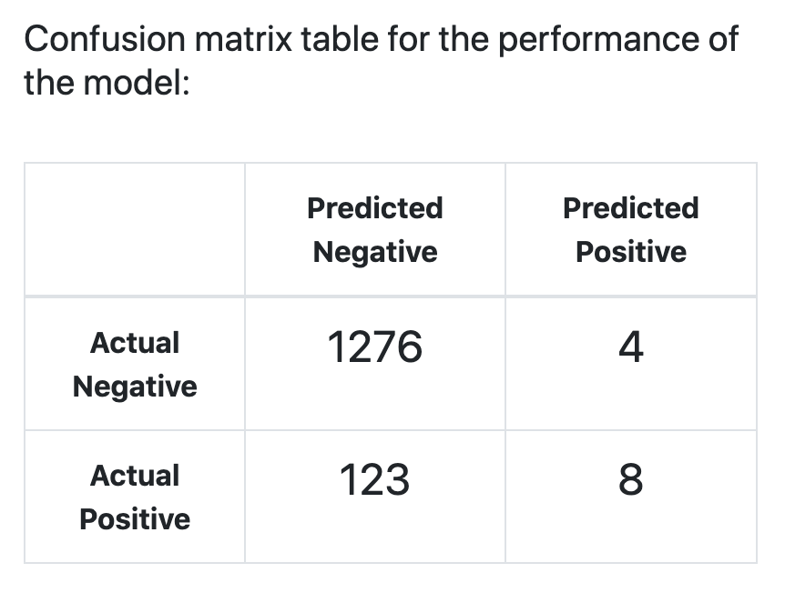
Random Forest Classifier Model Continued, Summary :
Random Forest Classifier Model Continued, Summary:

Slide 15
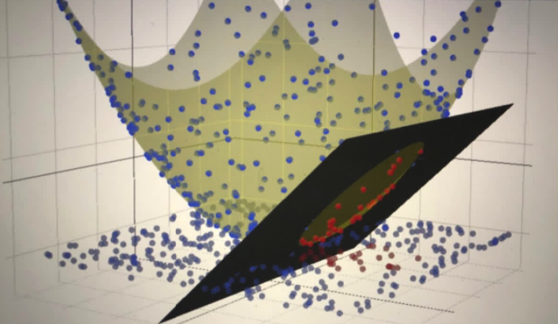
Support Vector Machines
SVC Model
Support Vector Machine (SVM) are supervised machine learning models that leverage associated learning algorithms for classification and regression analyses. SVM classification is based on establishing an often high-dimensional hyperplane, where a complex data set is separated into groups.
Visualization of a high-dimensional hyperplane.

Slide 16
SVC Model - implementation
The effectiveness of an SVM depends upon:
Selection of Kernel
The selection of which kernel to use comes down to your dataset and whether data points are linearly or non-linearly related. We tried three kernels to find the one which worked best (polynomial, rbf, linear)
B) Kernel Parameters
The gamma parameter in SVM tuning signifies the influence of points either near or far away from the hyperplane. For a low gamma, the model will be too constrained and include all points of the training dataset, without really capturing the shape. For a higher gamma, the model will capture the shape of the dataset well.
C) Soft Margin Parameter C
Too high and the model will overfit to the training data. Too low and the model will misclassify results.
In order to find the best parameters for C and gamma, we use a grid search to iterate over many different values of each to determine the best. Ultimately, we chose a polynomial kernel with gamma value of 0.001 and C value of 1.

Slide 17
Comparison
Model | True Negative | True Positive | False Positive | False Negative | Total
LR | 128 | 12 | 3 | 7 | 150
RFC | 1276 | 8 | 4 | 123 | 1411
SVC | 1270 | 7 | 3 | 131 | 1411
Note: LR model excludes rows with missing data. RFC and SVC models fill in empty rows with column mean.

Slide 18
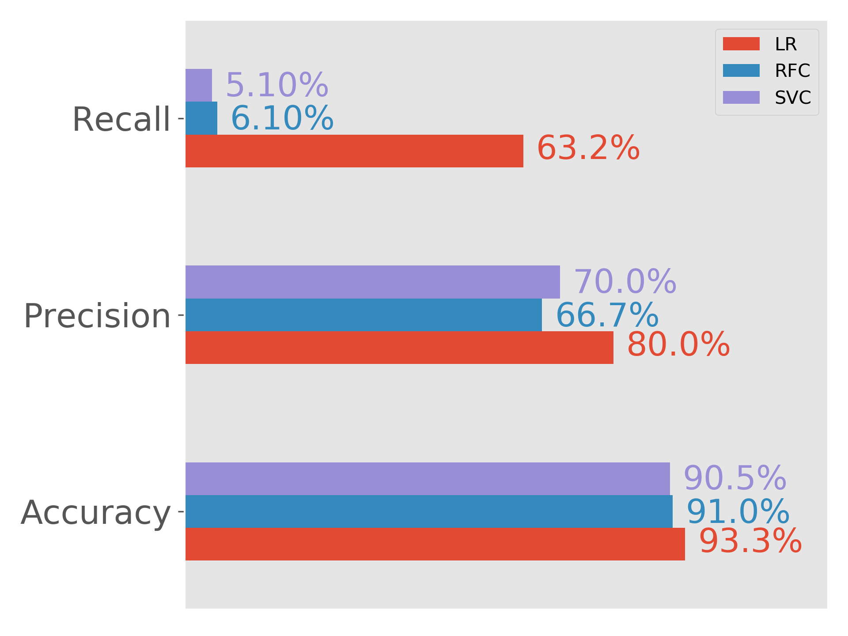
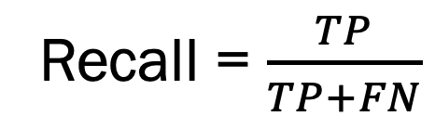
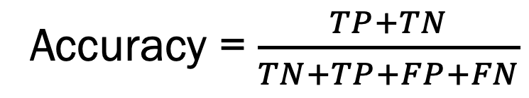
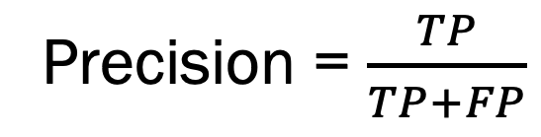
Comparison
Recall = $\frac{TP}{TP+FN}$
Precision = $\frac{TP}{TP+FP}$
Accuracy = $\frac{TP+TN}{TN+TP+FP+FN}$

Slide 19
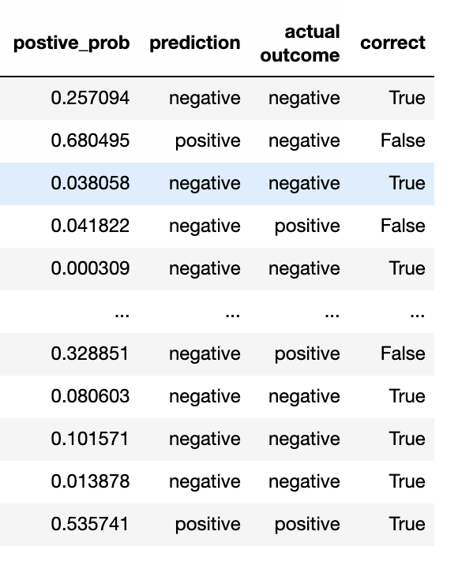
Probability Predictor Option
Alternate approach: Give % likelihood vs T/F response
Explicitly acknowledges uncertainty in prediction.
Enables tradeoff in sensitivity to False Positives vs. False Negatives.
Uses the same classifier models, but with Scikit-Learn predict_proba() method.

Slide 20
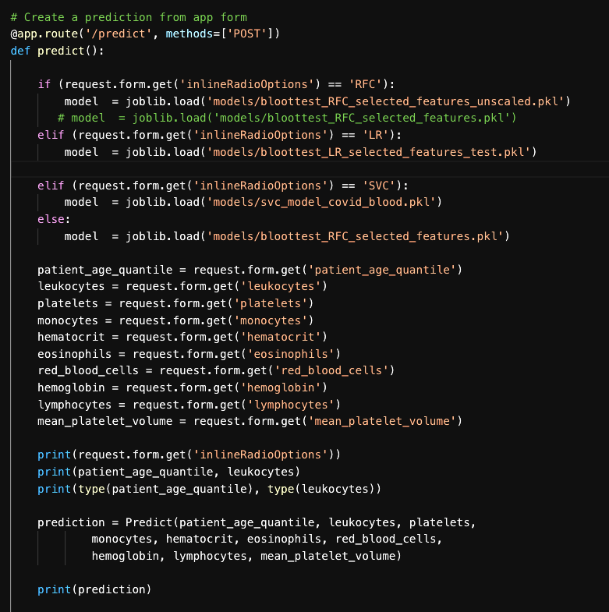
COVID-19 Prediction Models Based ON Non-COVID Lab Tests
The COVID Story
Data, Preprocessing, Modeling
Full Stack Deployment
Arundhati Chakraborty • David Jaimes • Grant Thompson • Alexis Perumal
UCSD Data Science and Visualization Boot Camp
May 13, 2020

Slide 21
Building the server and Routes
To Deploy our models for predictions we are using Python Flask that interact with ORM SQLAlchemy classes and flask-marshmallow /marshmallow-sqlalchemy for serializing and deserializing the data, render the html page that contains our Model related details. Our database is SQLite which we use to store user entered form data using Post Rest APIs

Slide 22
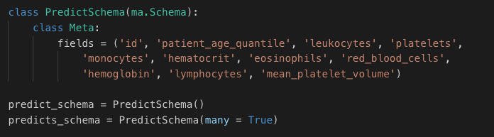
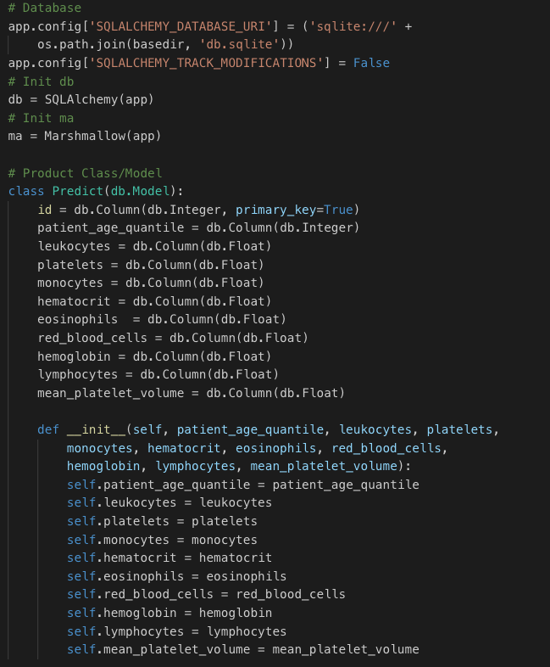
Building the ORM classes, Schema, SQLite database
We are using Python Flask for building a server that interact with ORM SQLAlchemy classes and flask-marshmallow /marshmallow-sqlalchemy for serializing and deserializing the data, render the html page that contains our Model related details. Our database is SQLite which we use to store user entered form data using Post Rest APIs

Slide 23
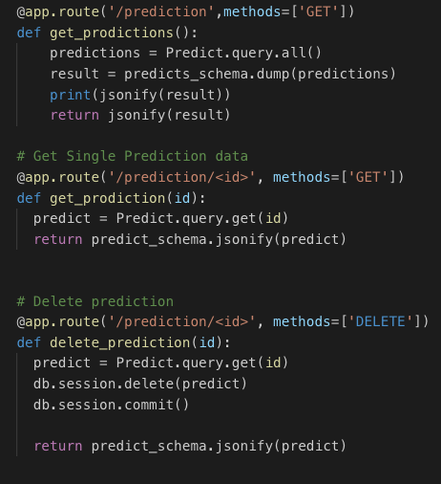
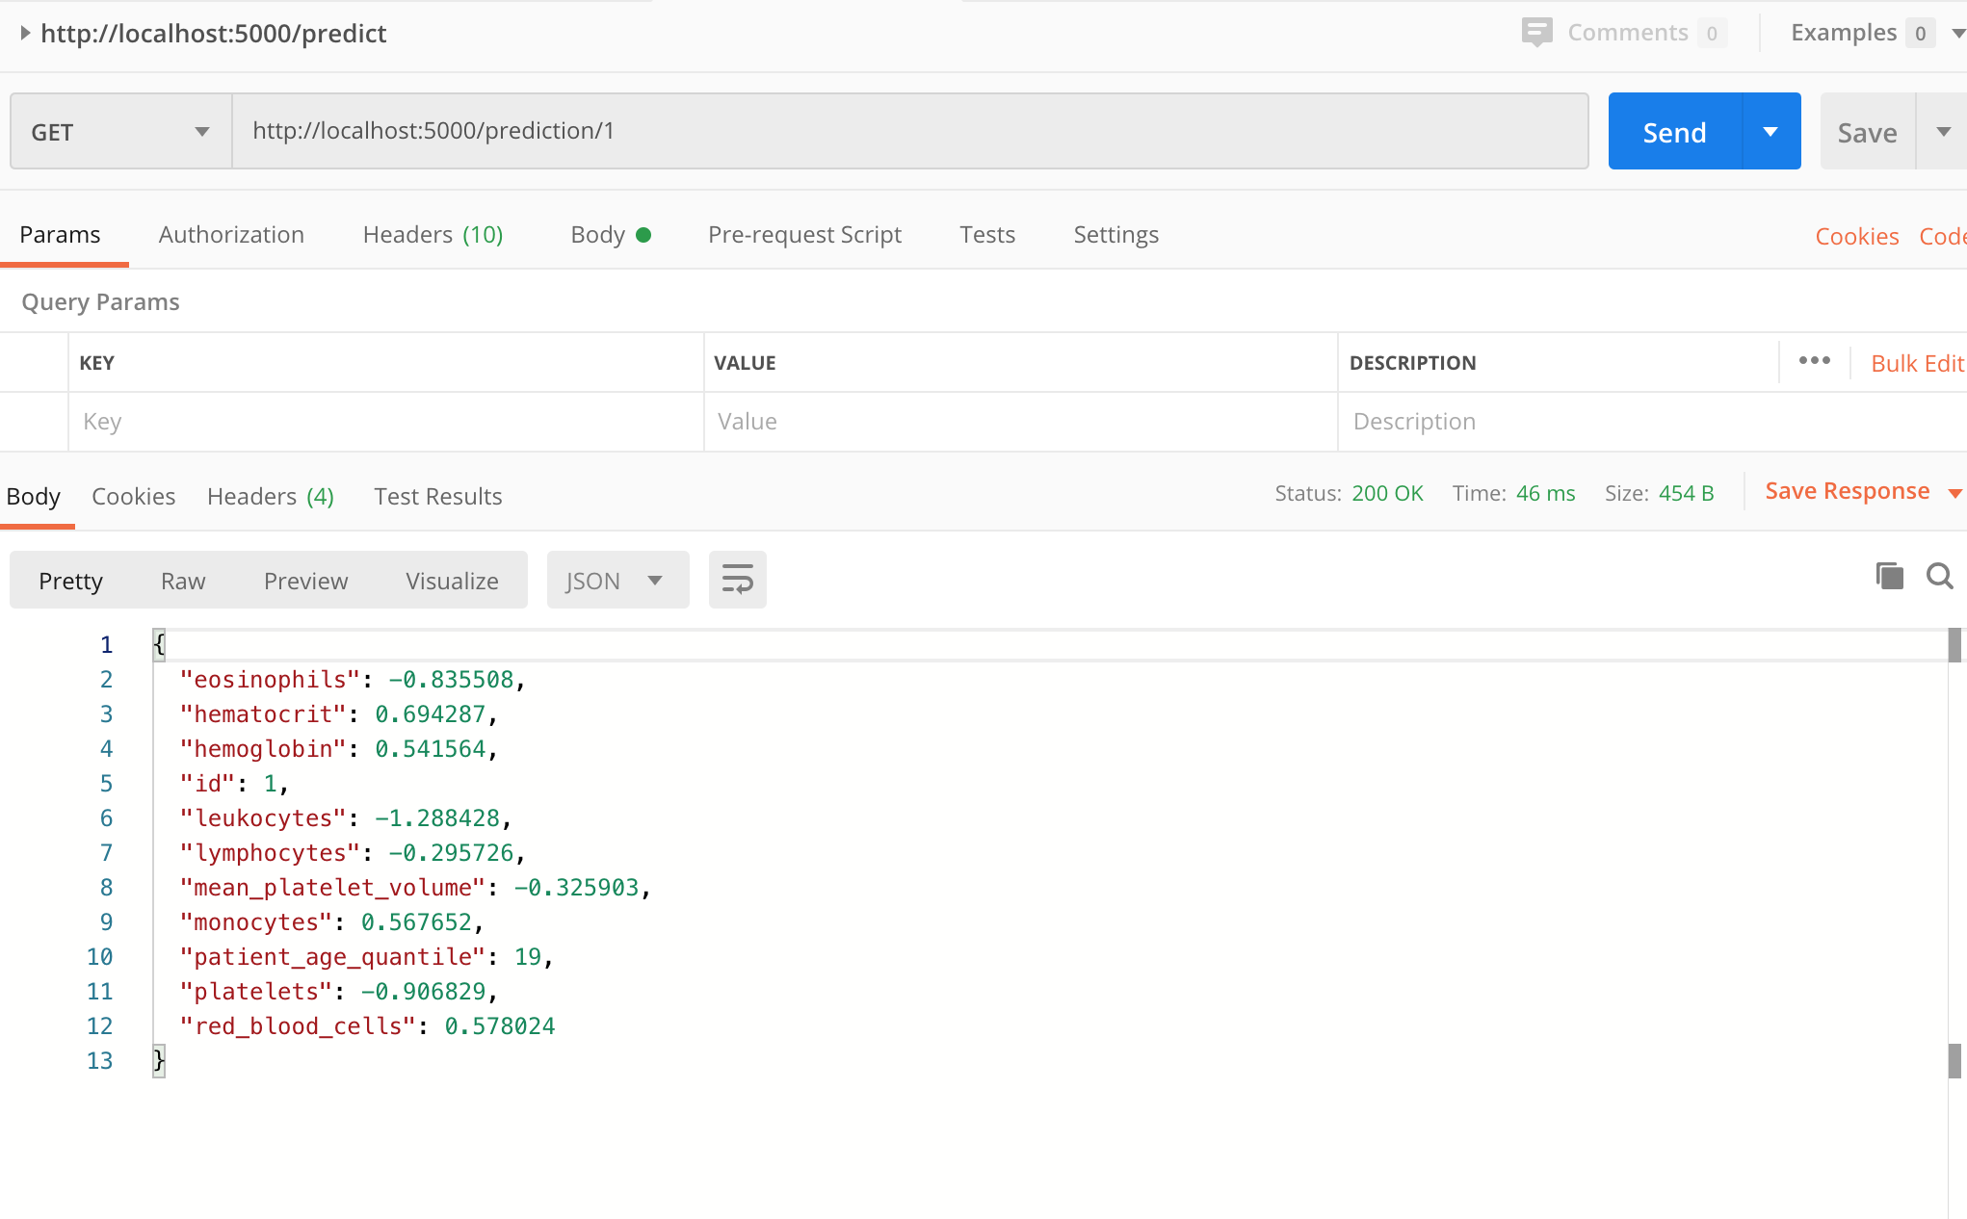
Rest APIs : Post,Get, Get(id), Delete(id)
Though we need just Post rest api to create each prediction form entry per patient, we created other rest apis Get all, Get(id), Delete(id) etc…. To interact with our SQLite database for completeness and we tested these APIs using Postman (collaboration platform for API development.)

Slide 24
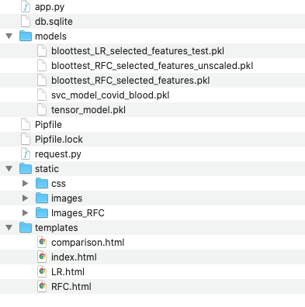
Front-end side preparation, Folder structure
Now that we have the server side code and database.
We connect our models to the prediction form
We will also be using Bootstrap for responsiveness, CSS for styling to display each page

Slide 25
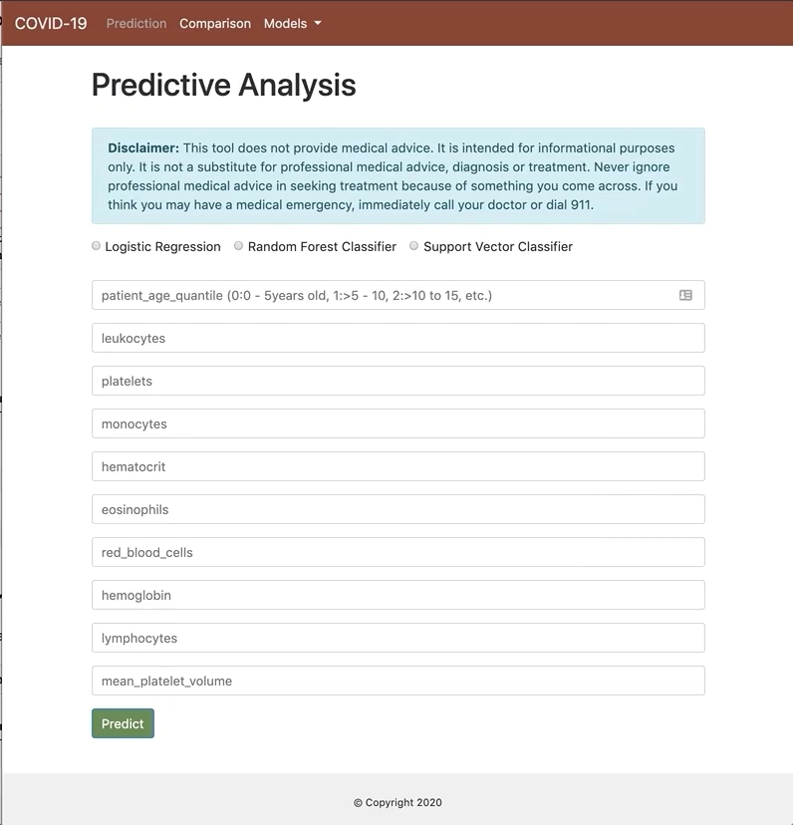
Prediction Entry Form

Slide 26
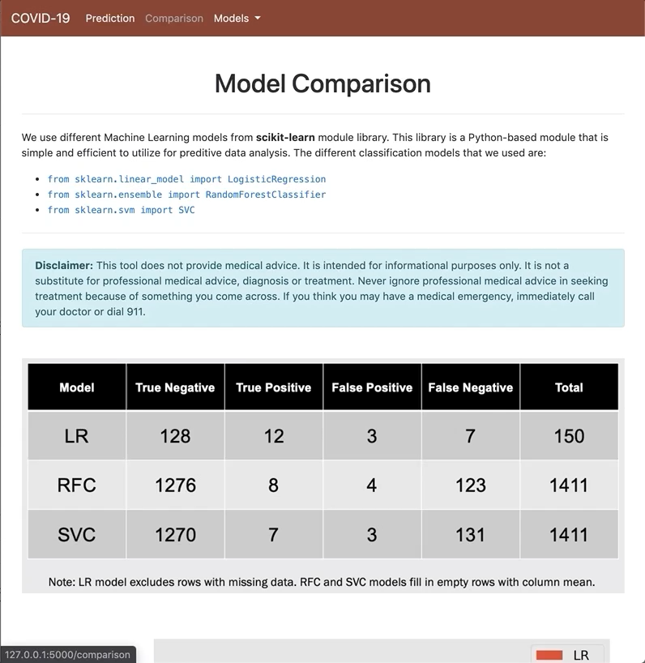
Additional Pages

Slide 27
COVID-19 Prediction Models Based ON Non-COVID Lab Tests
The COVID Story
Data, Preprocessing, Modeling
Full Stack Deployment
Arundhati Chakraborty • David Jaimes • Grant Thompson • Alexis Perumal
UCSD Data Science and Visualization Boot Camp
May 13, 2020

Slide 28
Conclusions
The Concept of using off the shelf blood tests to predict likelihood of a novel respiratory disease was prototyped.
Although accuracy was relatively high, >90%, recall (ability to correctly identify positive cases) was relatively low, ~60%.
Production usage requires much greater accuracy and recall.
High quality prediction models require much larger datasets, >10^4 samples, even with modern ML algorithms.

Slide 29
Questions

Slide 30
Thank You

